Slide 1


VALUATION
Pieter Dorsman
Vancouver
June 3, 2019

Slide 2

About
Pieter Dorsman
President & CEO, Redpeaks Management Inc.
Director, Angel Forum, Vancouver
Project Manager, NACO Common Docs
Chairman of the Board, Lambda Solutions Inc.
Director & CFO, E-Fund
Co-founder, Actenum
Former investment banker with UBS and Barclays
Twitter: @PieterDorsman
E-Mail: pieter@redpeaks.com

Slide 3
Trends for Angels & Entrepreneurs
Disruption across all sectors
Lower cost to start
Increase in starting age
Regional centres
Dispersed teams
Data & analytics
Growth of ecosystems
Deep pools of finance

Slide 4
Valuation
Focus is on pre & early revenue companies
$ Amount divided by all securities = share price
$3.5 Million
Pre-Money
$2.0 Million
Angel Round
$5.5 Million
Post-Money

Slide 5
Valuation Approaches
Comparable Method
Berkus Method
Risk Factor Summation
Scoreboard Valuation
Venture Capital Method
‘Local’ VC Method
Discounted Cashflow Method
First Chicago Method
Book Value Method
Liquidation Value Method
Conformity Method
Cost-to-Duplicate Method

Slide 6
Canadian Market
Considerable variation in valuations
Peaks at $2–4 million (21%) , $6–8 million (24%) and $10 million and above (15%)
Contrasts with previous years: majority of valuations were less than $4 million (63% in 2016 vs 37% in 2017
So: we are still in a very bullish market
Source: NACO Annual Report 2017-18

Slide 7
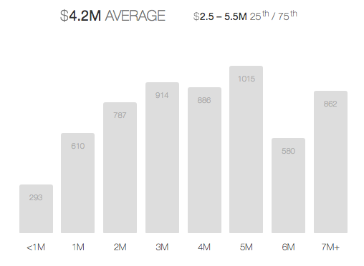
AngelList (US)

Slide 8
Founder Emotion
Fear of giving up control:
forced out of company
giving up long term financial upside
Ego: “my vision, only I can bring it to fruition !”
But also:
Being seen as a seasoned negotiator

Slide 9
Founder Emotion & Dilution – Case Study
Vancouver-based fintech company
Angel round of $1 million at $4.4 million pre-money, 18.5%
Strategic investor comes in, total $2 million, so now 31.5%
Founder initially had mixed feelings, but:
More than fully funded
Strategic partner brings significant revenue
So the $ value of the company increased exponentially despite increased dilution

Slide 10
Time is the Factor
Entrepreneur:
Goal is to finance your burn to the next financing round
Optimize the amount you can get in the market
Balance dilution against funds required to next round
Investor:
Goal is to ensure a position that will increase in value
Optimize the investors stake in the company
Assess the need to write a cheque again if funds run out

Slide 11
Case Study – ‘Typical SaaS Deal’
Local SaaS company raises $1.5m against $4.5m valuation = $6 million post
Revenues of $350k (some of it ARR)
Net burn is $85k = 18 months to get to cashflow positive or next financing round
Problems:
Can they justify $6 million minimum in next round ?
Can they even get to the next round on funds just raised?
Maybe only be 15 months if you add in finance cost
And … doing an external round takes at least 6 months

Slide 12
High Valuation
Negatives:
Harder to increase value in next round
You can raise a lot > leads to spending a lot
Increased likelihood of downround
Creates tension with investor group
Early stage: not overly fair to friends & family

Slide 13
Low Valuation
Negatives:
Hard to increase value in next round
Negative signal to future investors
Dilutive to founders – demotivating
Might attract wrong type of investors
Non-alignment founders-investors

Slide 14
Tools to Manage Valuation
Convertible or a SAFE – postpones lengthy debate
Price Protection
Liquidation rights

Slide 15
Case Study
ROI of Convertible Debt vs. Equity Investment
Exit
ROI – Convertible Debenture – 7X
ROI – Share investment – 14X
Valuation
New Money Here @$3m
Conversion value
with 33% discount
= $2m valuation
Angel Common Share investment @ $1M
Convertible Debenture @$0
Year

Slide 16
Case Study - Convertible
Canadian games company:
Convertible: C$5m Cap, 8% interest, 15% discount
Total raised $750,000
Two years on, acquisition
US$3.5 million or C$5 million (at the time)
Convertible (+ interest + discount) converted C$1 million
CAGR 15.76%
Who made money on the deal ?

Slide 17
Price Protection
Full Ratchet
In a downround all original investors get repriced at new round
Retroactive measure
Very dilutive for founders
Weighted Average
In a downround all original investors get to top-up at an average price
Blends the original share value and the new (lower) share value
Weighted based on how dilutive the event is.
Share Compensation
Guaranteed higher price for next round
Bonus shares (or dividends) tied to revenue levels

Slide 18
Tips for Founders & Angels
Try a few valuation methods + market comparables
Look at your long-term return, not position of today
Negotiate if possible – but take ‘holistic’ approach
Think of the relationship going forward
And note that:
Founders can set valuation at outset
Angels can only set valuation with 1st or a ‘big’ cheque

Slide 19
Core Principles of Valuation
Subjective measure = art > science
Based on information available at the moment
Subject to market pressures
Investor & Founder need to both feel ‘uncomfortable’
Never look back, ever

